Slide 1
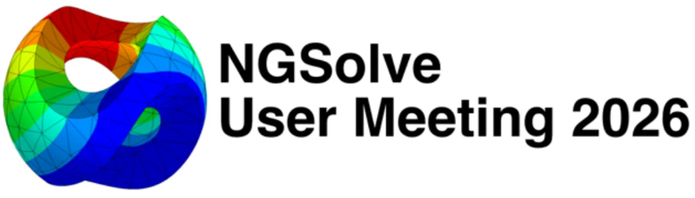


Coreform Cubit Integration with NGSolve
Kengo Sugahara
June 30, 2026
Notes:
Hello, I'm Kengo Sugahara from Kindai University. Today I'll talk about integrating Coreform Cubit with NGSolve.

Slide 2


GitHub repository: Radia (Forked)
Electromagnetic apparatus design powered by NGSolve
Induction heating
Electromagnets
Maglev
NMR coils
WPT systems
Printed circuits
https://github.com/ksugahar/Radia
Notes:
I have forked Radia, a Magnetic Moment Method solver originally built for undulator magnet design at the ESRF synchrotron, and coupled it with NGSolve into an integrated electromagnetic field simulation environment. We use it for many kinds of electromagnetic apparatus design, including induction heating, electromagnets, magnetic levitation, NMR coils, wireless power transfer, and printed circuit boards. The great advantage of the Magnetic Moment Method is that you do not have to mesh the air region. Let me explain why we combine it with NGSolve. NGSolve is a powerful general-purpose FEM, but the parts that are awkward for electromagnetics, such as open boundaries, the field from thick coils, and thin conductors, are exactly where FEM alone struggles. Combining it with the Magnetic Moment Method, which gives the field analytically without meshing the air, fills these gaps nicely. In fact, combining MMM with NGSolve is common. In today's induction heating example, the coil side uses PEEC and the workpiece side uses BEM. For magnetic levitation, our student will present right after this talk. And for accelerator magnets, it is standard practice to combine the analytic field from thick coils with FEM. On the other hand, the magnetic parts still need a volume mesh, and for engineering models the quality of the hex mesh governs the result. So, in addition to Netgen, we use Coreform Cubit as the mesher.

Slide 3
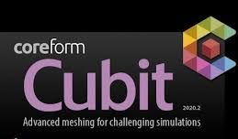
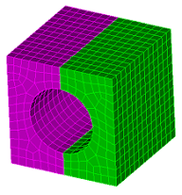

Coreform Cubit
Post-processor
Mesh generator
Both originate at Sandia National Lab
High-quality hex meshing
Associate license for non-commercial research
Used by Manfred’s group
Notes:
First, let me place Cubit in context. Coreform Cubit is a commercial build based on Cubit, which was developed at Sandia National Laboratories. As a side note, ParaView, which we often use for post-processing, also comes from Sandia. So Cubit and ParaView share the same origin and form a pair: Cubit for pre-processing, that is geometry and mesh, and ParaView for post-processing, that is visualization. Cubit's strength is turning complex CAD shapes into analysis-ready models, assigning blocks and sidesets, and producing high-quality meshes including hex. It can build not only hex but also mixed tet-and-hex meshes. And for students and non-commercial use there is a free Associate license, which makes it easy to adopt in a lab.

Slide 4
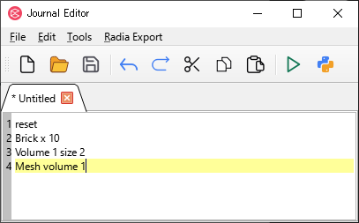
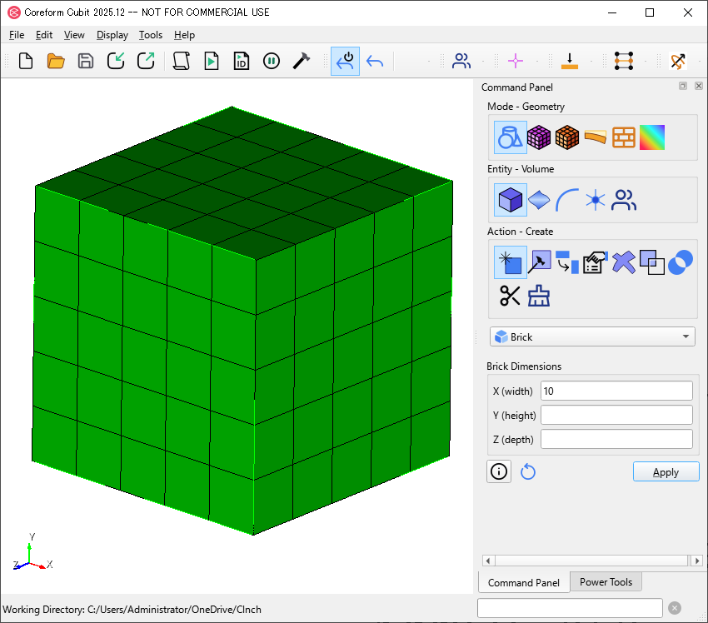
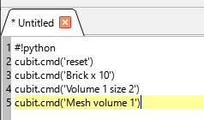
How to use Coreform Cubit
GUI window
APREPRO script window
#!python
cubit.cmd ( f ' brick x 10 ')
n = 1
cubit.cmd ( f ' volume{n} size 2 ')
cubit.cmd ( f ' mesh volume {n} ')
Python script window
1
Notes:
A convenient thing about Cubit is that the same operation can be driven from several entry points. The first is the APREPRO journal file. It is like a scripting language for Cubit: you save the meshing steps as a dot jou file and replay them while changing parameters. The second is the Python API. By calling cubit dot cmd from Python, you issue, from a program, the same commands you would in the GUI. This also matters when an AI agent drives Cubit. The third is the GUI. So that students in the lab or engineers at our collaborators can work without writing Python directly, it is important that they can use export and analysis panels from the GUI. The GUI is especially useful when you do not yet know the right operations to get a good mesh and need trial and error, looking at the CAD on screen and checking each operation. And importantly, every GUI action is recorded as a journal, so the work is reproducible and easy to reuse on other shapes and conditions.

Slide 5
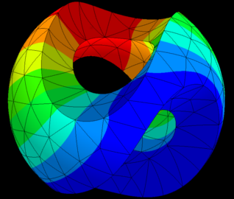
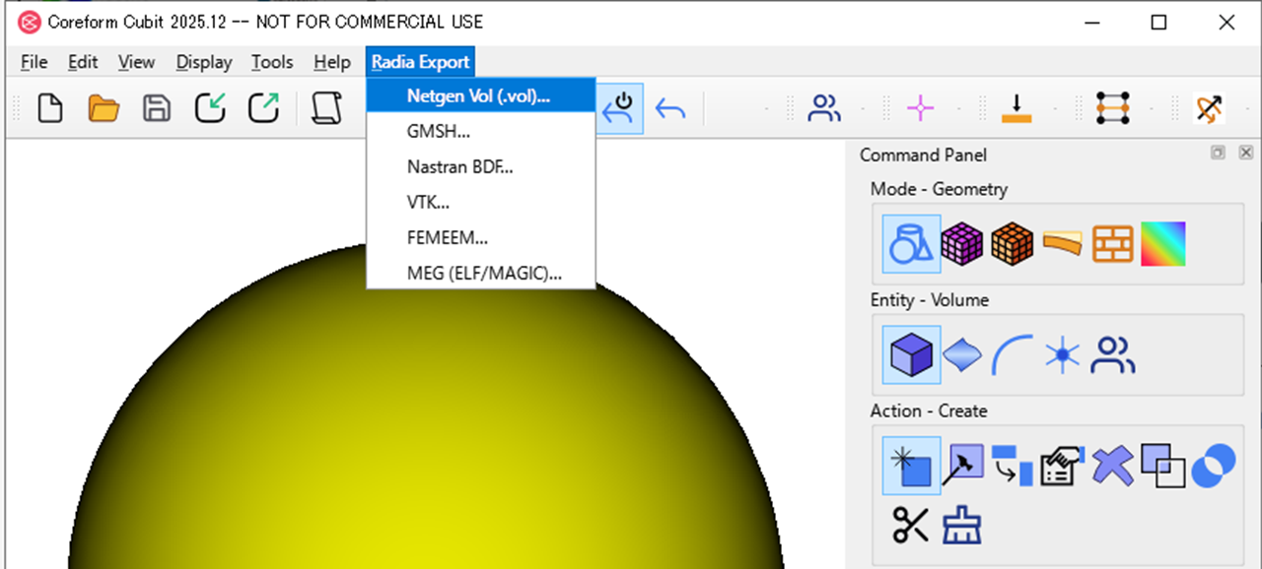
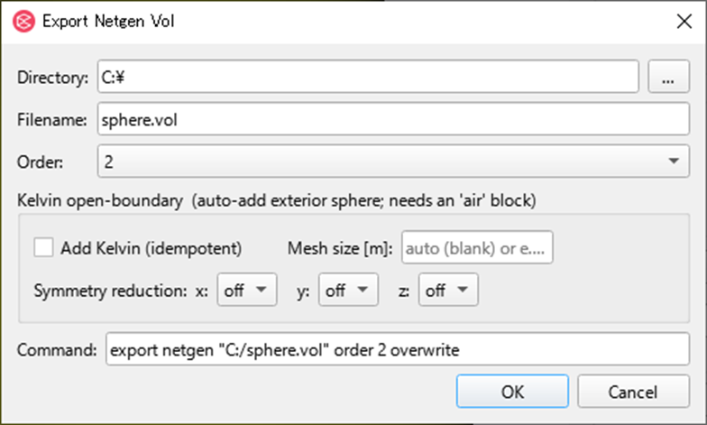
C++ Plugin
Cubit Plugin (C++)
Netgen/NGSolve
Cubit Plugin
Cubit Plugin Window
Notes:
To connect Cubit and NGSolve, we built a C plus plus Cubit plugin. With the Cubit SDK you can extend the GUI and add custom commands. With this plugin, you can call export to Netgen's dot vol format from the Cubit menu. The same function is callable not only from the GUI but also from APREPRO journals and from the Python API. So whether the user works by hand or automates with a script, everything goes through the same export netgen pipeline.

Slide 6
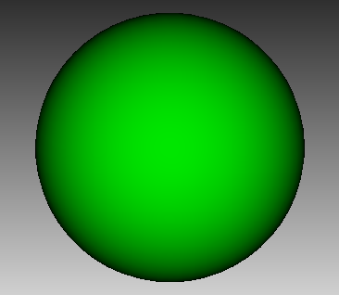
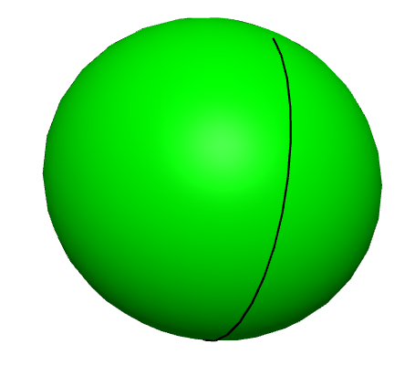
CAD Kernel: ACIS vs Open Cascade
Cubit Plugin (C++)
Netgen/NGSolve
Unexpected seam
STEP export/import
NOT compatible!
ACIS kernel
OCC kernel
Notes:
This was the most important problem in the development. Netgen's standard CAD handling assumes Open Cascade, while Coreform Cubit uses the ACIS kernel. At first glance you could just write a STEP from Cubit and read it back in Netgen, but that cannot rebuild a high-order mesh reliably. STEP is a neutral format, yet even for the same cylinder or torus, ACIS and Open Cascade may interpret the face partitioning, the seam locations, the trim curves, and the UV coordinates differently. So if you hand Netgen only the STEP geometry, the UV, and the linear mesh connectivity, it cannot safely decide which original ACIS curve or surface each high-order node should return to.

Slide 7
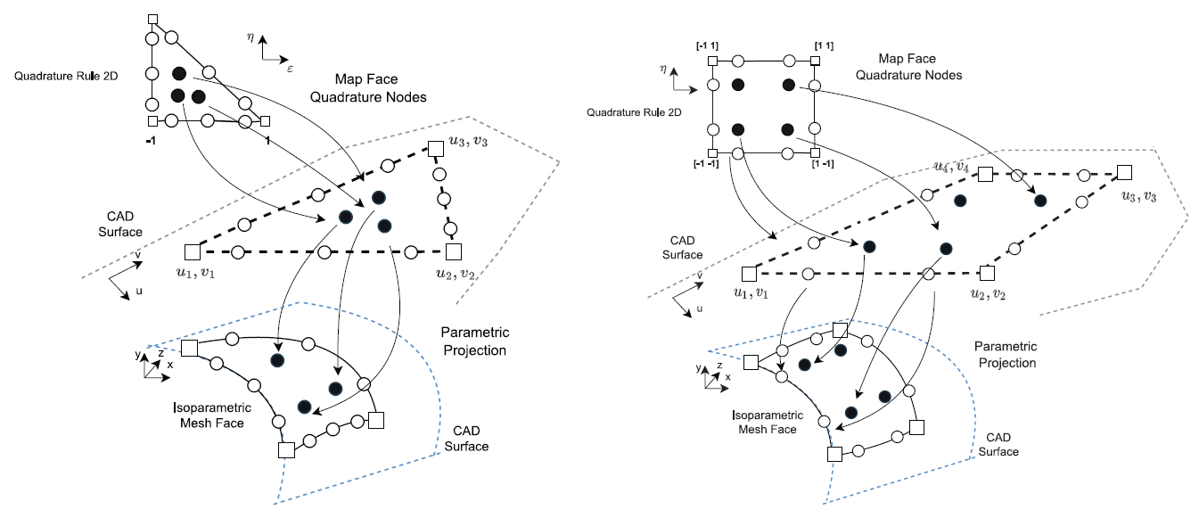
ACIS-aware high-order curving in the plugin
Cubit Plugin (C++)
Netgen/NGSolve
Portable Netgen for p>1 curves
CallbackGeometry
BuildCurvedElements
meshing.Mesh.Save()
High-order curvilinear mesh generation from third-party meshes
Computer-Aided Design 2026
Thanks to Joachim
Notes:
So, at the moment the high-order nodes are created, we query the original Cubit ACIS geometry directly. However, linking full Netgen into the plugin would cause DLL conflicts and Python ABI problems. So we embed only the necessary parts of Netgen: CallbackGeometry, BuildCurvedElements, which makes the high-order curved elements, and the part that writes the dot vol file. Cubit does the mesh generation, and the Netgen subset curves it while projecting onto Cubit's ACIS geometry, saving a dot vol that NGSolve can read. The key option for the user is the curve order: specifying order three, for example, outputs an order-three curved mesh. The topology is kept as is, and only the added high-order nodes are projected onto the ACIS surfaces, so we can treat geometry order and solver order separately. Note that ACIS is not thread safe, so this curving runs sequentially. The foundation of this curving is Joachim's Netgen: CallbackGeometry and edge project were merged upstream. I am deeply grateful that NGSolve and Netgen are developed in such an open way.

Slide 8
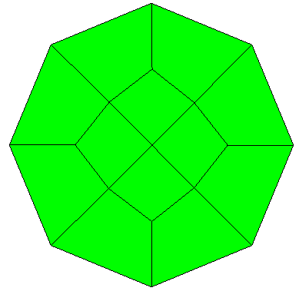
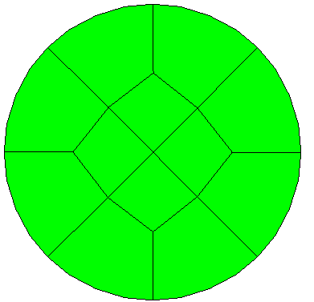
2D intuition: curved geometry matters
p = 1
p = 3
ΔΣ > 10%
ΔΣ < 1%
(Accuracy not confirmed)
Notes:
First, a two dimensional picture for intuition. At order one, a curved boundary is approximated by straight polygons, so the area is off significantly. As we raise the order, the boundary approaches the CAD curve and the area error shrinks. Note that the curve order is set on the plugin side, that is, at export time, so to compare different orders you have to prepare the dot vol files at each curve order in advance. On the next slide, we measure this in three dimensions as a volume error.

Slide 9
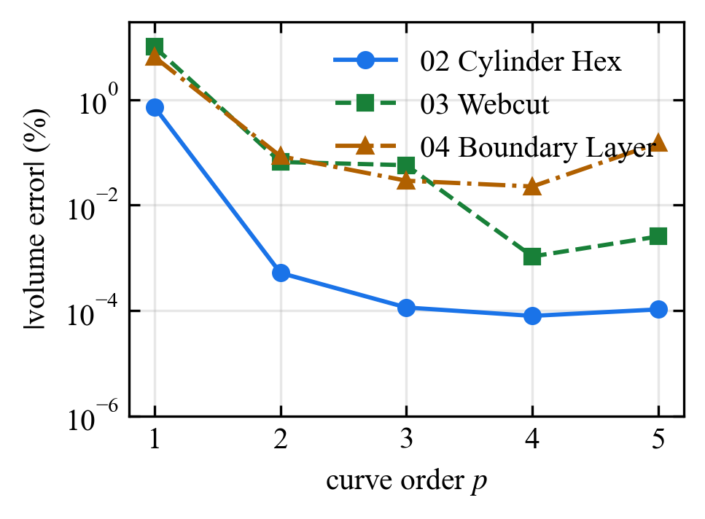
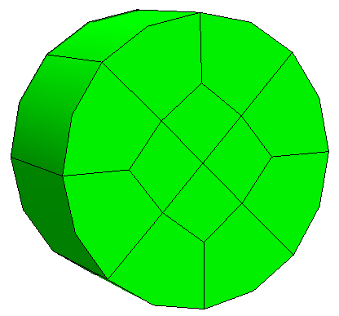
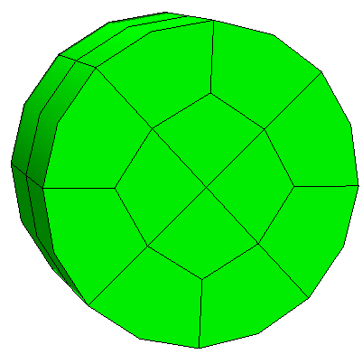
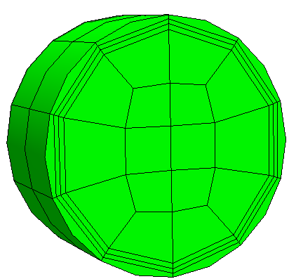
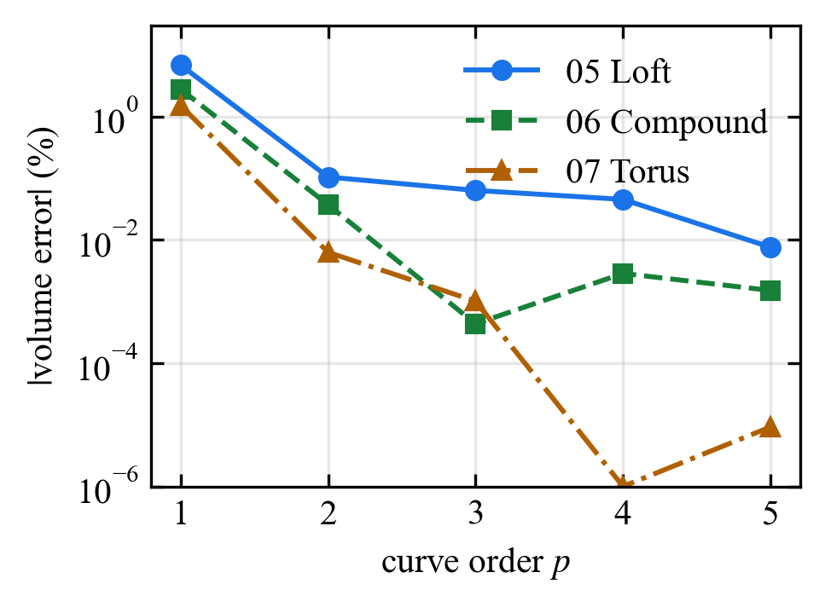
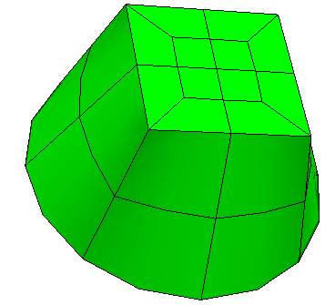
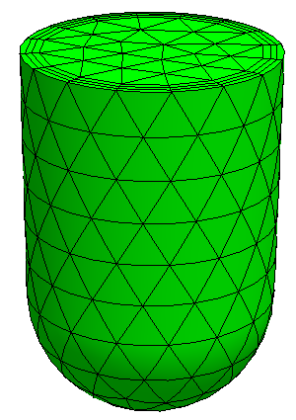
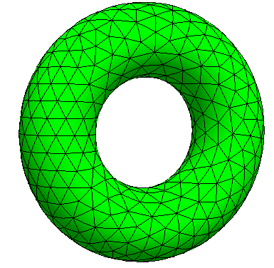
3D validation: volume error (ΔV)
02 | 03 | 04
05 | 06 | 07
hex
hex
hex
Cylinder Hex
Webcut
Boundary
Layer
hex
tet
tet
p-convergence
at least up to p = 3
Loft
Compound
Torus
Notes:
We compared the volume error across seven three-dimensional models. One honest caveat, though: here we treat the area and volume reported by Cubit as the true values and measure the error against them, but those true values themselves are not verified. A flat brick has zero error to begin with, so it needs no curving. Analytic surfaces, like a cylinder or a sphere, converge well as the order increases. Concretely, even a coarse cylinder of about forty elements gains digits of accuracy per order, although with too few elements order five can get slightly worse; while a torus with about ten thousand elements still improves at order five. The loft and the boundary layer models plateau at about zero point six percent, a known ACIS limitation for compound surfaces. The p-convergence behavior depends on the shape, but it holds at least up to order three, so we believe it is broadly fine; guaranteeing it for an arbitrary CAD shape is, honestly, hard. This is not just about appearance: for computations where the boundary shape, volume, area, and normals matter, such as BEM, surface impedance, induction heating, and Radia's magnetic discretization, the geometry order directly affects the result.

Slide 10
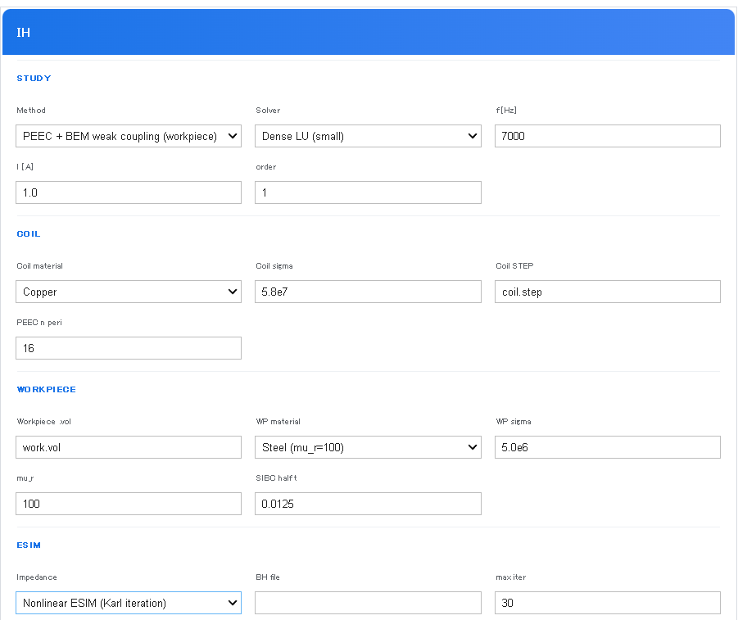
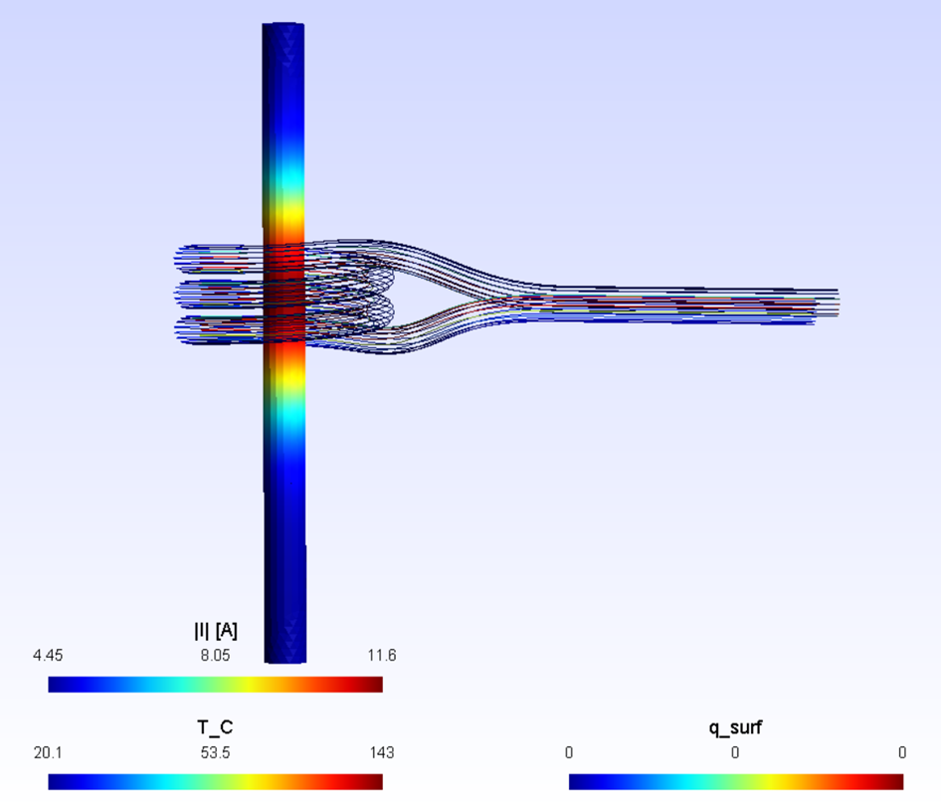
NGSolve-based IH workflow: Integrated electromagnetic field simulation environment
GUI on Jupyter Notebook
Induction Heating Simulation
PEEC for coil
BEM + ESIM
(Effective Surface Impedance Method)
ESIM: K. Hollaus, V. Hanser, M. Schöbinger, IEEE Trans. Magn. 2025, doi:10.1109/TMAG.2025.3613932
Notes:
As an application, here is an induction heating workflow centered on NGSolve. The theme is not induction heating itself, but that the dot vol made in Cubit becomes the direct entry point to the analysis. This is a workflow we develop as an interface for students who change coil shapes and run experiments in the lab. The coil and the workpiece are each meshed in Cubit and exported as separate dot vol files. From a notebook GUI panel you set the input files, frequency, current, and material; a headless solve runs behind it; and the results are saved as JSON, logs, and figures. Both the input dot vol and the resulting dot sol are imported into the notebook and viewable with netgen dot webgui. The main solver is NGSolve's BEM with surface impedance, the coil side is handled by Radia's PEEC, that is, Partial Element Equivalent Circuit, and the two are solved with weak coupling. Since the coil's skin effect can be captured by a surface impedance, a lightweight PEEC is enough for it. For nonlinear steel the surface impedance depends on saturation, so we use the ESIM of Hollaus and colleagues. Because ESIM evaluates the surface impedance from the surface geometry, Cubit's high curve order matters here too. We can also use a per-node surface impedance based on the local mesh curvature, which improves accuracy on curved geometries by about a factor of ten.

Slide 11
Summary
Summary
• Cubit: geometry, mesh, labels, high-order curving
• Embedded Netgen subset: portable .vol export (curve order p = 1..5)
• NGSolve: FEM / BEM / SIBC computation
• Radia: PEEC / induction-heating application layer
• Notebook GUI: reproducible, shareable workflow
github.com/ksugahar/Radia — Thank you for your attention!
Notes:
To summarize: the heart of this work is building a stable file contract and operation contract between Cubit and NGSolve. Cubit handles geometry processing, meshing, labels, and high-order curving; the embedded Netgen subset writes the dot vol; NGSolve does the FEM, BEM, and surface impedance computation; and Radia provides PEEC and the application layer. By making all of this drivable from a GUI and from a notebook, we want to build a reproducible workflow usable not only by researchers fluent in Python, but also by students and engineers at our collaborators. Thank you for your attention.

